Slide 1
CPAP/BiPAP Machines as one Treatment Option for Sleep Apnea
Massachusetts Department of Developmental Services
February 2020
Notes:
Hello and welcome to the latest webinar in a series of topics related to health, safety and quality improvement for the Mass Department of Developmental Services. This webinar is brought to you by the Office of QM and the Center for Developmental Disabilities Evaluation and Research. My name is Courtney Dutra, I’m from CDDER and I’m pleased in introduce our topic today: CPAP/BiPAP Machines as one treatment option for sleep apnea

Slide 2
Agenda
Brief Overview of Sleep Apnea
Explain CPAP and BiPAP machines
What they are and how they work
Images of different models
Brief Overview of DDS Protocols
Video demonstration of how to clean machines
How to assist with compliance and usage
Troubleshooting
Resources
Notes:
Today’s topic will touch briefly on how Sleep Apnea is defined and diagnosed and the explain one specific treatment option which is the use of CPAP and BiPAP machines. We’ll show you the different parts of the machine and how to clean them, as well as tips for compliance, usage, and troubleshooting. We will also briefly introduce the DDS Protocols related to sleep apnea.

Slide 3
Sleep Apnea is a serious condition
Affects 8% of adults in DDS services (NCI survey 2017)
More common in William’s syndrome, Prader Willie syndrome and Down syndrome:
50% of people with Down syndrome
More likely as adults progress through dementia.
Rates of sleep disorders range from 44% to 83% of people with Autism Spectrum Disorder
Notes:
Sleep apnea is a serious condition and affects about 8% of adults in DDS services. It is more common in adults with certain syndromes: William’s syndrome, Prader William’s syndrome and down syndrome. Research show that obstructive sleep apnea is present in at least 50% of people with down syndrome., and that sleep difficulties in general increases as the person moves through the stages of dementia. Sleep disorders are also more common in people with ASD with 44% to 83% of people reporting a sleep disorder.

Slide 4
Medical conditions
Increased risk of abnormal heart rhythms (arrhythmias)
Greater risk of coronary artery disease, heart attack, heart failure and stroke
High blood pressure
Impaired glucose tolerance and insulin resistance
Frequent nighttime urination
Depression
Menstrual irregularities
Some research has found a connection between obstructive sleep apnea and glaucoma
Notes:
Here is a list of medical conditions are associated with sleep apnea, including greater risk of hear attack, stroke, and impaired glucose tolerance.

Slide 5
Associated conditions
Reduced attention
Poor impulse control
Difficulties with daytime functioning
Poor mood and behavior regulation
Impaired memory
Notes:
In addition, a person may have these affects from sleep apnea:

Slide 6
Sleep Apnea is a serious condition
People may not realize they have sleep apnea
Treating sleep apnea can dramatically improve a person’s quality of life
Notes:
For all these reasons, treating sleep apnea can dramatically improve a person’s quality of life!

Slide 7
Speaker
Holly Saurman, the Director of Respiratory Therapy (RT) at Tewksbury Hospital
35 years of experience working as a RT in the Commonwealth
Notes:
Our presenter is Holly Saurman, the Director of Respiratory Therapy at Tewksbury Hospital. Holly has over 35 years experiences working as a RT for the DPH and also provides care for the DMH and the DDS. Without further ado I’d like to turn it over to Holly.

Slide 8
What is Sleep Apnea?
Notes:
It’s so much more than snoring! Although that is often one of the first symptoms people associate with this condition

Slide 9
Sleep Apnea
Two types of sleep apnea
Obstructive Sleep Apnea (OSA)
Most common
Central Sleep Apnea (CSA)
Involves neurological components
Notes:
These interruptions in sleep can happen hundreds of times per night, affecting deep sleep or REM cycles.

Slide 10
Sleep Apnea
Airway is narrowed or partially blocked during sleep.
The brain signals the body to increase efforts to breath – which briefly awakens the brain so that the airway can stiffen and open the throat.
Efforts to breathe then decrease again and the brain goes back to sleep.
Hundreds of times a night!
Notes:
These interruptions in sleep can happen hundreds of times per night, affecting deep sleep or REM cycles.

Slide 11
Sleep Interruptions
People with sleep apnea may not get enough oxygen during sleep and probably don’t sleep soundly.
As a result, likely see excessive daytime sleepiness, irritability, poor concentration, etc.

Slide 12
Other Possible Signs:
Abrupt awakenings accompanied by gasping or choking
Frequent night wakening
Nighttime sweating
Loud snoring
Waking with a dry mouth or sore throat
Morning headaches
Poor concentration or forgetfulness
Mood changes, depression

Slide 13
How is sleep apnea diagnosed?
Health Care Provider orders a sleep study
Commonly performed at home
Or in a hospital sleep lab if:
Already using a PAP device
Already using oxygen
PAP treatment is not effective
Diagnosed with sleep apnea (based on results)
CPAP or BiPAP ordered (if applicable)
Many modules are ‘Automatic’ and will self-adjust pressure based on person’s needs.
Notes:
Signs and symptoms are present, the HCP will order a sleep study
Note on Automatic module that we may wish to share: If the sleep study is performed at home, it cannot be titrated to a specific pressure. Sometimes the person is diagnosed and treatment begins, but family or staff will notice that the person is still having the same symptoms. The HCP will then recommend that the person go into a sleep lab for a more thorough, advanced sleep study. This allows in-depth study of additional sleep variables that are not looked at in-home.

Slide 14
CPAP and BiPAP’s
Notes:
This is one of the most commonly prescribed treatments for Sleep Apnea.

Slide 15
What do they do?
Continuous Positive Airway Pressure (CPAP) machine delivers a predetermined level of pressure which helps to keep the airway open under continuous pressure.
Bi-Level Positive Airway Pressure (BiPAP) machine delivers two levels of pressure, one when the person breathes in and one when they breathe out.
Notes:
CPAP and BiPAP systems help people breathe more freely and restfully
Homecare company will tell them. Machine will say it on them.
This should also be part of their care plan

Slide 16
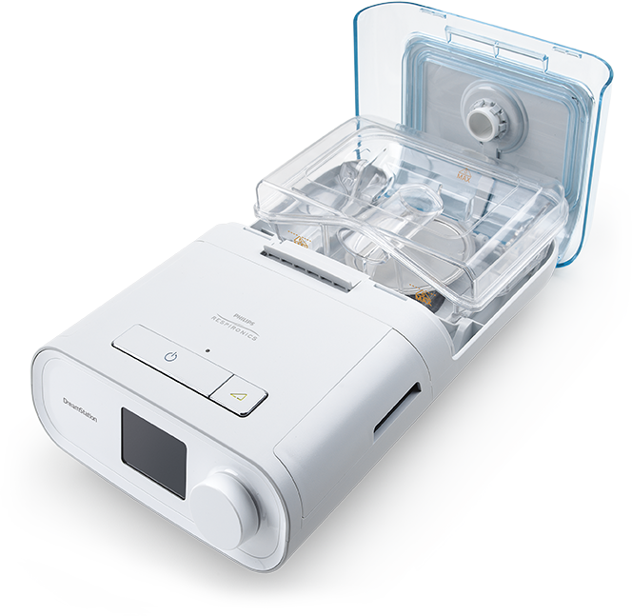
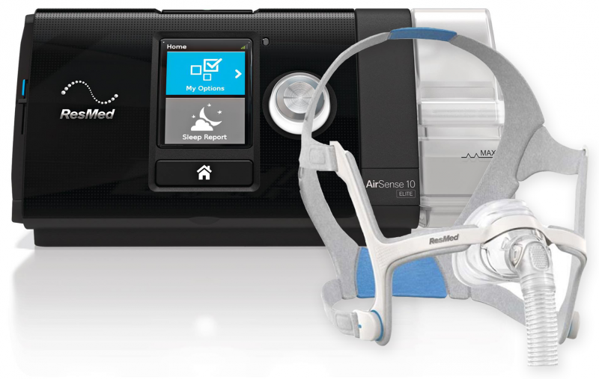
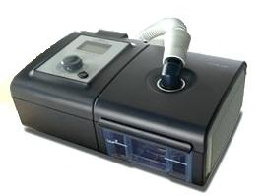
Examples of PAP Devices
AirSense by ReSmed
DreamStation by Respironics
System One by Respironics
Notes:
Message “All look different; staff need to know their product”. Here are some images of commonly used models.
Concept is the same, just look a little different

Slide 17
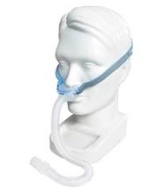
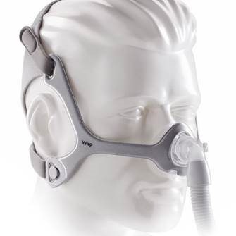
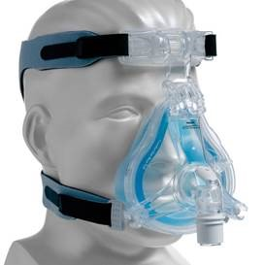
Face masks
Nasal Pillow
Nasal Mask
Full-Face Mask
Notes:
What are the parts that make up these machines?

Slide 18
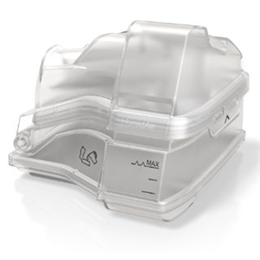
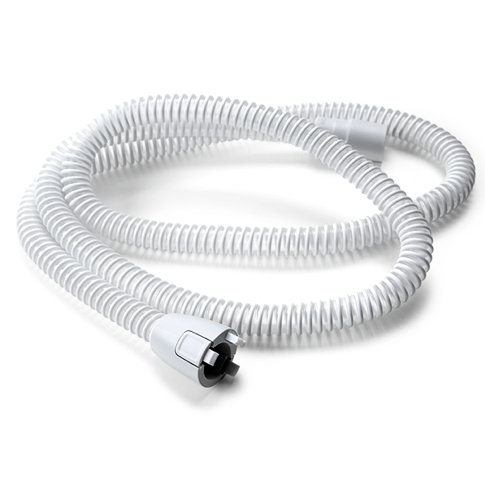
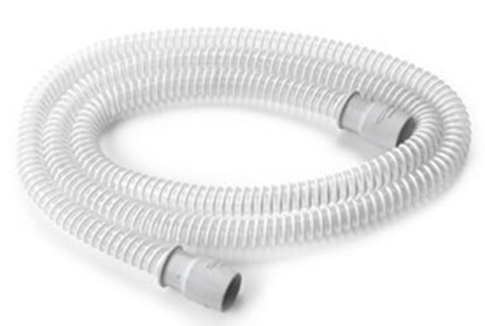
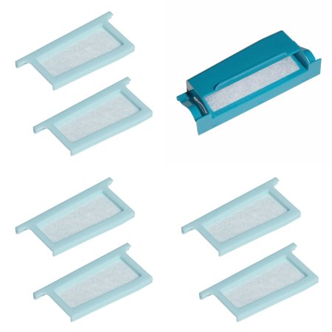
Tubing, Filters and Chamber
Heated Tubing
Humidifier Chamber
Standard Tubing
Filters
Notes:
What are the parts that make up these machines?
Standard tubing is universal and will work with all machines. Heated tubing will only work with the machine that it is made for.
If you use the heated tubing, you can put distilled water in your reservoir and breath in moist air instead of regular air.

Slide 19
Important Consideration
A person who is unable to remove a mask on their own should NEVER use a full face mask
There is a risk of aspiration from vomiting during the night

Slide 20
Placeholder for possible video showing how to use the machine
If being used with Oxygen--Always turn on CPAP machine before turning on O2 concentrator. Turn off O2 concentrator before turning off CPAP machine.
Do not tip the machine
Notes:
Courtney note: Do we need this level of detail? How hard or easy is it to use one of these machines?

Slide 21
If CPAP is used with oxygen
Always turn on the CPAP machine before turning on the oxygen concentrator.
This will reduce the risk of spark!
Notes:
Courtney note: Do we need this level of detail? How hard or easy is it to use one of these machines?

Slide 22
Never tip the machine!
Do not tip the machine if the humidifier chamber has water in it!
Try two-sided Velcro tape to secure the machine to the bedside table
Avoid clutter!
Notes:
Courtney note: Do we need this level of detail? How hard or easy is it to use one of these machines?

Slide 23
Cleaning and Replacement of Parts
Each manufacturer has its own recommendation for cleaning and replacement schedules.
Replacement is primarily driven by insurance
Standard time frames: 30-60 days; 60-90 days
Review with the home care company
Develop a schedule

Slide 24
Staff Training
Staff need training on the individual’s equipment: mask, nasal pillow, machine.
A Respiratory Therapist or a trainer from the home care company should do the initial training, including:
How to assemble and disassemble the machine
How to maintain the machine
How to clean parts
How to operate comfort modes

Slide 25
Comfort Measures
Ramp (pressure), moisture (humidity, and temperature.
Pressure is specific to prescription written at diagnoses.
Ramp will start the pressure at a lower rate for a specific period of time, then it will increase to the prescribed pressure.
Not all people need ramp. It’s a personal preference!
Notes:
Video explanation of ramping that is good

Slide 26
Compliance and Usage

Slide 27
Usage is Monitored
Once home care company sets up the device, they’re going to monitor usage over a period of time.
Compliance is defined as “at least 4 hours a night of use.”
Home care company will outline specific requirements
If non compliant, unit may be removed
Notes:
Use is monitored through cellular data
Mass Health guidelines. Is it 60 days for the 4hour a night of use

Slide 28
How to help the person be compliant
Don’t be hard on yourself; set a goal!
Start small with 2 hours a day for a week
Increase to 4 -6 hours
Often person feels MUCH BETTER and will want to continue

Slide 29
Compliance
Some people may resist the sensation of the mask, touch, pressure, or noise
Let the person handle the mask, turn it on and off, etc.
Provide encouragement and support
Documentation is critical

Slide 30
Troubleshooting and Questions

Slide 31
Symptoms that may indicate the machine is not working well
Still have daytime sleepiness
Constant runny nose or cold symptoms
Still snoring
Call the Primary Care Provider!

Slide 32
Common Problems
Machine is not plugged in
Won’t turn on
Other error codes
Hose or Mask Leak

Slide 33
Hose/Mask Leaks
Usually hose leaks are from a split
Mask leaks are usually due to a poor fit
Watch for (visible or person complaining):
Dry, itchy eyes
Red marks on bridge of nose
Red marks on top of lip (below nose)
Person will complain they don’t have enough pressure

Slide 34
Questions
Questions about the machine can be directed to the company
Report error codes immediately
Leave a message and a RT will return the call
Homecare companies will have staff on 24/7.

Slide 35
Cleaning

Slide 36
All models need cleaning!
Follow manufacturer’s instructions
Do:
Use distilled water only
Use moisturizer-free soap
Remove tub first and then fill with water
Do Not:
Tip the machine
Run through dishwasher
Move the machine with water in it!
Consider securing the machine to bedside table
Notes:
Do not tip the machine-especially when water is in water tub.
NEVER pour water near machine..

Slide 37
Suggested Daily Routine
Remove mask/nasal pillows from individual.
Turn of oxygen
Turn off machine and let it cool down.
Remove water tub carefully so it does not tip and leave lid open to dry.
Drain water tub and clean water tub according to manufacturer’s instructions.
Remove the face mask/nasal pillows and clean according to manufacturer’s instructions.

Slide 38
Suggested Weekly Routines
Remove the face mask from the headgear (straps).
Clean the mask and head gear according to manufacturer’s instructions
Clean the face mask, water tub, headgear (straps), and CPAP hose according to manufacturer’s instructions. Make sure they are completely dry before reassembling.
When reinserting pillows or cushions into headgear inspect visually and correct if any gaps are seen.
Remove the filter from the machine. Clean or replace it according to manufacturer’s instructions.
Use an anti-bacterial wipe on the exterior of the unit

Slide 39
Unique considerations
Manufacturer cleaning protocol may not take into consideration exposure to bodily fluids. In those instances, cleaning would happen immediately.

Slide 40
DDS Protocols
Notes:
Each program is expected to have an individualized protocol
Why?

Slide 41
List of what must be included
A copy of the Health Care Provider (HCP) order
Reason for use
How to operate equipment including detailed responsibilities during various parts of the process:
Bedtime
Morning
Weekly and biweekly cleanings
How to clean and maintain equipment according to manufacturer’s instructions
When and how to order new parts from the medical supply company
How use is documented

Slide 42
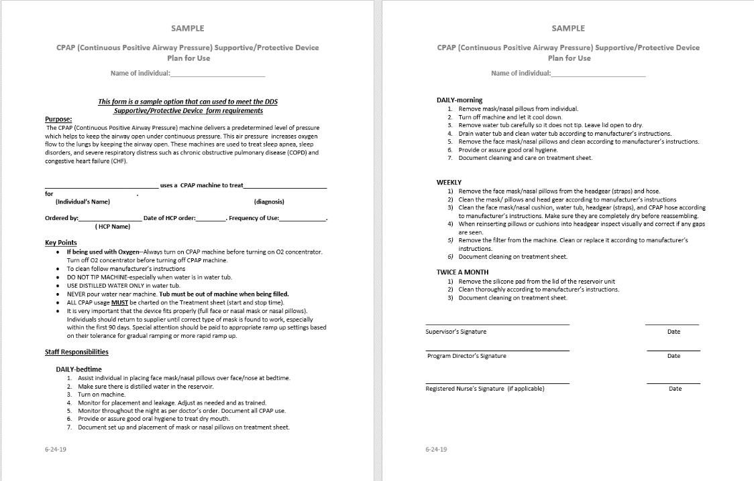
Cleaning Schedules
Specific to manufacturer and company
Notes:
DDS requires that the Individualized Protocol include instructions for how to clean the device. This is a sample. A link at the end of this presentation will take you to this.

Slide 43
List of what must be included cont.
Plan for assuring compliance and, if necessary, desensitization to equipment
Frequency of monitoring and observation during use
Clear instruction on what to report to supervisor and HCP (Health Care Provider)
Notes:
Any of these items may indicated a poor mask fit, leak in the machine, or pressure/oxygen settings that are not accurate.

Slide 44
Sample protocols are available:
All of the DDS CPAP/BiPAP guidelines and protocols can be accessed here: https://www.mass.gov/lists/health-and-safety-guidelines#cpap/bipap-use-
CPAP SP Device Cleaning
BiPAP SP Device Cleaning
Blank CPAP Supply Replacement Schedule
Guidance on Management of Diagnosis of Sleep Apnea
Sample Individualized Health Care Protocol for Management of Sleep Apnea
Supportive Protective Device

Slide 45
Video Demonstrations

Slide 46
Resources

Slide 47
American Sleep Association: https://www.sleepassociation.org/sleep-disorders/sleep-apnea/
All of the DDS CPAP/BiPAP guidelines and sample protocols can be accessed here: https://www.mass.gov/lists/health-and-safety-guidelines#cpap/bipap-use-
Other quality management webinars:
https://shriver.umassmed.edu/programs/cdder/dds-webinars

Slide 48
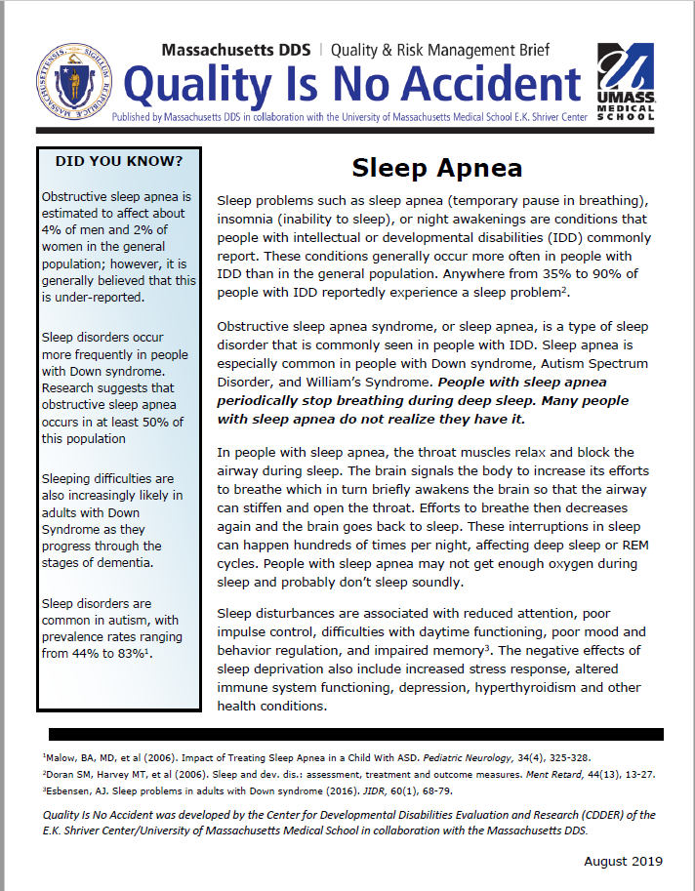
QINA Brief
DDS/CDDER QINA Brief on Sleep Apnea: https://shriver.umassmed.edu/sites/default/files/QINA%20sleep%20apnea_final.pdf

Slide 49
Research Resources
Malow, BA, MD, et al (2006). Impact of Treating Sleep Apnea in a Child With ASD. Pediatric Neurology, 34(4), 325-328.
Doran SM, Harvey MT, et al (2006). Sleep and dev. dis.: assessment, treatment and outcome measures. Ment Retard, 44(13), 13-27.
Esbensen, AJ. Sleep problems in adults with Down syndrome (2016). JIDR, 60(1), 68-79.
Current Developmental Disorders Reports
June 2014, Volume 1, Issue 2, pp 74–85| Cite as
Sleep in Individuals with an Intellectual or Developmental Disability: Recent Research Reports

Slide 50
Thank you!
Produced by the Center for Developmental Disabilities Evaluation and Research, in conjunction with the Massachusetts Department of Developmental Services
https://shriver.umassmed.edu/programs/cdder
https://www.mass.gov/orgs/department-of-developmental-services

