Slide 1
Clozapine Therapy Training
Revised 3/27/2018
Notes:
Welcome to the Clozapine Therapy Training Webinar.
Clozapine therapy training and the required training guidelines is to be completed for each cert staff who will be administering Clozapine. Documentation of the training and the corresponding Training Guidelines must be on site and at the main office. This power point presentation is an optional tool that may be used to meet the training requirement.
Handouts for the training include:
MAP Policy 08-6 High Alert Medication-Clozapine Therapy
Agency specific Clozapine Therapy Policy
Sample Clozapine medications sheets (MARs)
Clozapine Protocol Template
Power point handouts may be optional
As a prerequisite to administering Clozapine, Certified staff must also have successfully completed Vital Signs Training.

Slide 2
Objectives
What is Clozapine used to treat?
What are the major side effects of Clozapine?
Who can administer Clozapine?
Why is regular blood testing required?
Notes:
Training of Certified staff in Clozapine therapy must be conducted by an RN, NP, RPh, PA or MD, with demonstrated understanding of the safe administration of Clozapine on a regular basis. If a Certified staff has not administered Clozapine for 12 months or more or has not demonstrated understanding of safe Clozapine administration, retraining needs to take place.
LPNs who have been trained themselves may provide subsequent Clozapine Therapy retraining.

Slide 3
Schizophrenia
Brain disorder
Chronic condition
Requires lifelong treatment
Notes:
Schizophrenia is a severe, chronic, brain disorder that distorts the way a person thinks, acts, expresses emotions, perceives reality and relates to others.
Symptoms may include: hallucinations (hearing voices or seeing people or things that are not real), delusions (believing things that are not true), trouble organizing thoughts, flat affect, showing a lack of pleasure for life or activities, having trouble focusing or paying attention.

Slide 4
Schizoaffective Disorder
Schizophrenia
Plus
Mood Disorder
Major Depression
Bipolar Disorder
Notes:
Schizoaffective disorder is when the individual has symptoms of schizophrenia (such as hallucinations or delusions) and also experiences symptoms of a mood disorder (such as major depression, mania or bipolar disorder).
Schizophrenia and/or Schizoaffective Disorder may impact all areas of daily living for an individual including home, work, social contacts and relationships. Some individuals diagnosed with Schizophrenia or Schizoaffective Disorder may show signs of suicidal behavior which refers to actions by the individual that put him/herself at risk for death.
While there is no cure for Schizophrenia or Schizoaffective Disorder, symptoms can often be controlled with proper treatment including the use of antipsychotic medications. Antipsychotic medications are used to manage the symptoms of schizophrenia such as hallucinations and delusions.

Slide 5
Clozapine
Clozaril©
Used to treat
Schizophrenia
Schizoaffective Disorder
Notes:
The brand name for Clozapine is Clozaril.
Clozapine is used exclusively in the treatment of Schizophrenia and Schizoaffective Disorder when other medications have been tried and failed or have caused serious side effects. The goal of Clozapine therapy is to eliminate the symptoms of Schizophrenia/Schizoaffective Disorder.
Only licensed staff and/or Certified staff, trained in Clozapine therapy management, may administer Clozapine.
If an individual is learning to self administer his/her own medications, he/she must be trained in Clozapine therapy management (both initially and ongoing education).

Slide 6
Clozapine
Requirements:
Valid HCP order
Agency specific Clozapine policy
Individual specific Protocol
Individual specific staff training
Completed evaluation tool
Notes:
Clozapine administration requirements include a valid HCP order, an agency specific policy which outlines emergency procedures to be followed when there is a medical emergency related to the administration of Clozapine, an individual specific protocol for each person prescribed Clozapine and completed individual specific evaluation tools (for each staff) for each person prescribed Clozapine.

Slide 7
Clozapine HCP Orders
Must include
Specific diagnosis for which Clozapine is prescribed
Instructions to call prescribing HCP if 2 or more days of Clozapine is omitted
Notes:
The Clozapine HCP order must also include instructions for staff to call the prescribing HCP if the individual misses 2 or more consecutive days of Clozapine before any further doses are administered.

Slide 8
Clozapine HCP Orders
Any order change must be
Communicated to all staff
Documented in individual’s record as a narrative note
Notes:
When there is a change in the Clozapine HCP order, the change must be communicated to all staff, this can be done verbally and/or in writing. The goal is: all staff are made aware that there was a change in the Clozapine HCP orders.

Slide 9
Documentation
Notes:
Documentation of the change in Clozapine HCP orders must also be written and filed in the individual’s record. Remember, any health related information should not be written in the staff log.
This is an optional form that may be used.

Slide 10
Clozapine HCP Orders
Once HCP signs & dates
Valid in program for
One year [DDS]
As deemed clinically appropriate by prescriber [DMH/DCF]
Notes:
In DDS programs signed and dated clozapine orders are valid for 1 year. In DMH and DCF programs all signed and dated psychotropic medications orders, including Clozapine are valid for what the prescriber deems as clinically appropriate.
Remember, if taking a telephone order, repeat the order back to the HCP after taking it to be sure you have taken the order accurately. Be sure to get it signed by the HCP within 72 hrs.

Slide 11
Common Side Effects
Constipation
Drooling
Sleep disorders
Increased sweating
Weight gain
Notes:
It is very important, when a person is taking Clozapine that they follow a routine, including exercise and a well balanced diet, this will help to limit some of the side effects. All side effects noted should be reported to the HCP.

Slide 12
Serious Side Effects
Agranulocytosis
Seizures
Orthostatic Hypotension
Bradycardia
Syncope
Myocarditis
Cardiomyopathy
Notes:
In addition to the common side effects, Clozapine has many serious side effects including: seizures, orthostatic hypotension (blood pressure suddenly falls when standing up or stretching), bradycardia (slow heart rate), syncope (fainting or ‘passing out’), myocarditis (inflammation of the heart muscle, which can cause heart failure) or cardiomyopathy (deterioration of the ability of the heart muscle to contract which also may lead to heart failure).
It is important to report any changes, behavioral or physical, to the HCP asap, it may be due to a medication side effect. However, the most significant side effect of Clozapine is agranulocytosis.

Slide 13
Agranulocytosis
Potentially fatal blood disorder
Low White Blood Cell (WBC) count
Great risk for infection
Notes:
The healthy body has an immune system which resists and fights infection. White blood cells are the infection fighting cells in the blood.
Agranulocytosis is a potentially fatal blood disorder in which granulocyte white blood cells (or WBCs) are not made, or not enough of them are made by the body, which may reduce the body’s ability to resist and fight infection.
When an individual receives Clozapine, there is risk of Agranulocytosis. Without white blood cells the body does not have a natural defense against even common bacteria and viruses such as the common cold. Therefore, if an individual had a low white blood cell count and they caught a common cold it could be fatal!
If Agranulocytosis is caught in the early stages it can be treated and reversed.

Slide 14
Before Starting Clozapine
HCP will order lab tests
ANC
Absolute Neutrophil Count
May also be ordered as
CBC with diff
Complete Blood Count with Differential
Notes:
Before initial clozapine therapy is started, the HCP will order lab tests to be sure that the individual’s neutrophil-white blood cells are at an acceptable level. Neutrophils are the most plentiful type, making up 55 to 70 percent of a person’s white blood cells.
The lab test the HCP will order is known as an ‘Absolute Neutrophil Count’, or more commonly called an ‘ANC’.
Or, another way the HCP may order the test is a CBC with diff (Complete Blood Count with differential).
Either way the test is ordered, the HCP will know if the individual’s neutrophil-white blood cell count is at an acceptable level, before starting Clozapine therapy. This also gives the HCP “baseline” levels to compare future lab tests to.

Slide 15
ANC Testing
Baseline levels then,
Weekly x6 months then,
Biweekly x6 months then,
Once every 4 weeks
Notes:
Once the baseline ANC labs are obtained and the individual is started on Clozapine he/she will still require frequent lab draws.
Typically, lab work is obtained every week for 6 months followed by, every 2 weeks for the next six months and then once every 4 weeks thereafter.

Slide 16
ANC Testing
If Clozapine is DC’d by HCP
Weekly labs for at least 4 more weeks
Notes:
In the event the HCP discontinues the Clozapine therapy for the individual, the ANC labs will still need to be monitored weekly for at least 4 more weeks.

Slide 17
Pharmacy Requirement
Current ANC levels
Current is within 7 days
Will only dispense enough Clozapine tablets until next blood test
Notes:
The pharmacy must be made aware of the ANC lab values, to be sure they are in an acceptable range, before they dispense any Clozapine.
It is important for Certified staff to know the agency process of how the pharmacy gets notified of the ANC lab results.

Slide 18
Pharmacy Requirement
Pharmacy will not dispense Clozapine without current levels
If lab value is more than 7 days
Must be redrawn
Notes:
The HCP can prescribe Clozapine, including refills, however; if the ANC lab values are not supplied to the pharmacy or the lab values are more than 7 days old, the pharmacy cannot dispense the medication: this is a Food and Drug Administration (FDA) requirement.
It is important to know that if the pharmacy does not have current (less than 7 days old) ANC lab values, the HCP would need to be notified so that the ANC labs could be ordered and the lab work obtained. The pharmacy would need to be notified of the lab work results so the Clozapine could be dispensed (* will only be dispensed if the labs are at an acceptable level). This process would always need to take place in a timely fashion so the individual would not miss a dose of medication.

Slide 19
Responsibilities
Certified staff must know
Clozapine specific system to prevent running out of meds
Upcoming lab work
Ordering/reordering
Notes:
The pharmacy will only supply enough Clozapine to last until the next ANC lab draw date. It is very important for Certified staff to know the scheduled lab dates and the ordering/reordering of Clozapine system, including how the pharmacy is notified of lab test results. Knowing and following these systems will ensure there is an adequate supply of Clozapine at the site and should avoid the possibility of running out of the medication.
A notation should be made in the Ordering/Receiving Logbook that corresponds with the lab draws to indicate that the Clozapine has been ordered and when subsequently received.
Remember, the pharmacy cannot dispense the Clozapine without the required ANC lab work results.

Slide 20
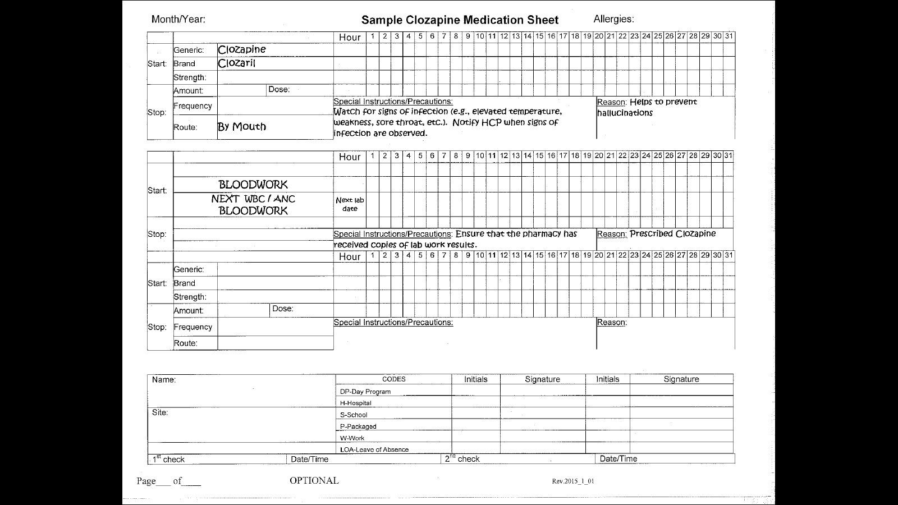
Medication Sheet
Notes:
The Clozapine medication sheet must include the next ANC lab draw date.

Slide 21
MAP Consultants
If a dose of Clozapine is missed contact the MAP Consultant
If 2 or more days are missed, do not restart without consulting the prescribing HCP first
Notes:
As with any medication, if a dose of Clozapine is missed the MAP consultant must be notified.
However, if 2 or more days of Clozapine is missed, the ‘prescribing’ HCP must be contacted first before administering any further doses.

Slide 22
Report Immediately
Signs and Symptoms of infection
Fever
Weakness
Lethargy
Sore throat
Confusion/Delirium
Notes:
Report immediately any changes, physical or behavioral, that are observed in the individual; changes observed may be a side effect of the medication.

Slide 23
Emergency Procedures
Know
Where to locate emergency policy/procedures
When to call 911
Who to notify in event of emergency
Notes:
Trainer- handout and review your agency Clozapine therapy policy/procedure and review with staff where they are located, when a phone call to 911 is necessary and if 911 is called, after the individual is cared for, who staff are to notify.

