Slide 1
Warfarin Sodium (Anticoagulant) Therapy Training
03/10/2015
Notes:
Welcome to the warfarin sodium therapy training webinar. My name is Carolyn Whittemore. I’m one of the Department of Developmental Services MAP Coordinators and I will be your presenter today. I would like to thank Courtney Dutra and Christine Clifford, from the Center for Developmental Disability Evaluation and Research at UMASS Medical School for their technical assistance in hosting this webinar.
Warfarin sodium therapy training and the required training guidelines are to be completed only for certified staff who will be administering warfarin sodium, including relief staff. Documentation of the training and corresponding Training Guidelines must be one site and at the main office.
This power point is an optional tool which may be used to meet the training requirement.
Handouts may include: MAP Policy#08-5, your agency Warfarin sodium medication sheets, your agency Warfarin sodium tracking system, Flow Sheets or Event Sheets, your agency Warfarin Sodium Therapy Policy, and protocols.

Slide 2
Objectives
1. What is an anticoagulant ?
2. Why is anticoagulant therapy necessary?
3. What is a PT/INR?
4. Who can give Warfarin sodium?
Notes:
Training of certified staff in warfarin sodium must be conducted by an RN, NP, Rph or MD, with demonstrated understanding of the safe administration of warfarin sodium on a regular basis. If a certified staff has not administered warfarin sodium for 12 months or more, retraining needs to take place. LPNs who have been trained themselves may provide subsequent warfarin sodium retraining.

Slide 3
Circulatory System
Heart
Pumps blood through the body
Delivers oxygenated blood
Returns deoxygenated blood to lungs
Notes:
We’ll start with a brief overview of the circulatory system. The heart acts as a pump to move blood throughout the body.
Arteries carry blood away from the heart and lungs, and is full of oxygen. After the Arteries deliver the oxygen throughout the body, the Veins bring the blood back to the heart where it is sent to the lungs to get more oxygen and then the heart pumps it out again. The cycle goes round and round. Oxygen is necessary for all parts of the body to function.

Slide 4
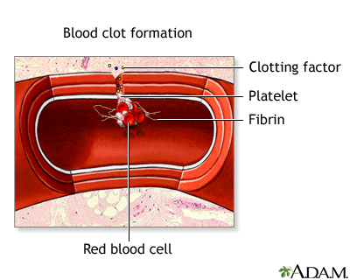
Blood Clots
Notes:
The healthy body has a process in place so that if we start to bleed it will automatically respond to stop the bleeding by forming a clot.

Slide 5
Good Blood Clots
Prevents or stops bleeding
Normal body function
Cut
Flossing teeth
Nosebleed
Accident
Notes:
A blood clot is necessary to prevent blood loss if accidental bleeding occurs, these are good blood clots.

Slide 6
Bad Blood Clots
Stops the normal flow of blood within the body
May cause
Heart attack
Stroke
Deep Vein Thrombosis (DVT)- blood clot in legs
Pulmonary Embolism- blood clot in lungs
Notes:
Some blood clots are not so good.
For example; if an individual has Atrial Fibrillation, which is when the heart has a fast, shallow beat, it will not pump the blood out the way it should. Some of the blood will get pumped out, but some of it will stay in, if it stays in for too long, a clot may form. If a clot forms, it may eventually get pumped out of the heart and then get stuck somewhere in the body. When a clot gets stuck in the blood system, normal blood flow stops and the surrounding tissue gets damaged because oxygen can no longer be delivered to that area. A clot can also start, or form, in different areas of the body besides the heart, for different reasons. If a piece of the clot breaks off, it too can get stuck somewhere in the body causing damage.
If the clot gets stuck in the lungs, this is called a Pulmonary Embolism. If it gets stuck in the brain, this is called a Stroke. If it gets stuck in the legs, this is called a DVT (Deep Vein Thrombosis). If it gets stuck in an arteriole of the heart it causes a heart attack. These are bad blood clots.

Slide 7
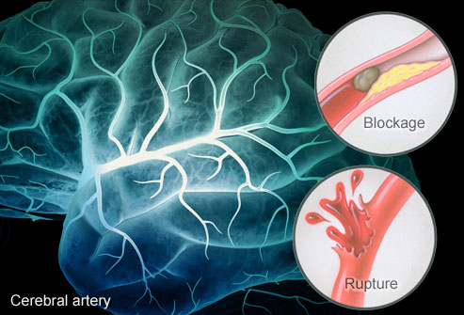
Stroke
Notes:
A Stroke is damage to the brain and can be caused by one of two things; The first is a blood clot in the brain which stops the flow of blood causing damage to that area of the brain. This can happen if a piece of blood clot, from a different area of the body, breaks free and then gets stuck in the brain. Or secondly, a vessel in the brain breaks, causing blood flow into the surrounding area, causing damage. This can be made worse if the body cannot form a ‘good blood clot’ to stop the bleeding.

Slide 8
Anticoagulant
Blood thinner
Brand
Coumadin
Generic
Warfarin sodium
Notes:
An anticoagulant is a substance (or medicine) that prevents blood from forming clots, often called a blood thinner. Warfarin sodium is an anticoagulant medication used to prevent harmful blood clots from forming. Often, Warfarin sodium is used in the treatment of: Atrial Fibrillation, after recent heart attacks, after certain surgeries, Deep Vein Thrombosis, or Pulmonary Embolism. Each individual who has Warfarin sodium ordered must have a specific diagnosis for its use. The key is to keep the blood flowing smoothly so bad blood clots will not form but the body is still able to form a good blood clot if needed. This is a careful balance that requires constant monitoring by blood tests.

Slide 9
PT/INR Blood Test
PT
Prothrombin Time
Used to measure how long it takes blood to clot
INR
International Normalized Ratio
A way of standardizing PT results no matter the testing method used
Notes:
When determined that an individual will be started on an anticoagulant medication, the HCP will order a PT/INR lab blood test and an individual specific ‘Target INR Range’. The Prothrombin Time or PT, measures how long it takes blood to clot and is used to monitor the effects of the anticoagulant medication or Warfarin sodium. Laboratories use different test methods to measure the Prothrombin Time . Since the PT test results are not consistent from lab to lab, it may be difficult for the HCP to determine the ‘desired effect’ of the Warfarin Sodium, just based upon the PT test result. For this reason, the PT results are converted, by the lab, into an INR result. The International Normalized Ratio (or INR) allows the Health Care Provider to understand the PT results even when they come from different labs or are done by different testing methods. Because of the different PT testing methods, it is important to realize that some labs, will only tell you the individual’s INR test result.

Slide 10
PT/INR Blood Test 2
PT
Prothrombin Time
INR
International Normalized Ratio
INR
Target INR Range
Notes:
After the INR is obtained, it is key to caring for the individual to know if the INR test result falls within the individual’s established ‘Target INR Range’. If it is not within the Target INR Range, the HCP may decide to change the Warfarin sodium dose. For example: if the individual’s established Target INR Range is 2-3, a PT/INR level is obtained. If the INR result came back as 1.8, that is too low, out of range and the HCP may order an increase in the Warfarin sodium dose. If the INR result came back as 3.6, that is too high, out of range, and the HCP may order a decrease in the Warfarin sodium dose. The PT/INR may be ordered monthly, weekly or even daily until the therapeutic effect of the medication is reached and the INR falls within the individual’s established ‘Target Range’. Remember: The HIGHER the INR: the longer time it takes for the blood to clot and the RISK of bleeding increases. The LOWER the INR: the RISK of forming a bad blood clot increases

Slide 11
PT/INR Blood Test 3
May be obtained at
Labs
Clinics
HCP visit
Home self-test kit
Lab home visit
Notes:
On the screen, is a list of where PT/INR blood tests may be obtained.

Slide 12
PT/INR Blood Test 4
If managed in a home setting
Must be performed by licensed staff
Certified staff are NOT permitted to perform the test
Notes:
If the PT/INR blood test is obtained in the home setting, the test must be performed by a licensed staff, certified staff are not allowed to perform the test.

Slide 13
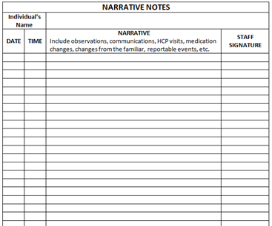
Narrative Notes
Notes:
Whenever there is a change in warfarin sodium orders, the change must be communicated to all staff. A note must be written in the person’s record. On the screen is an optional form that may be used.

Slide 14
Warfarin Sodium
Can be affected by
Illness
Infections
Diarrhea
Indwelling catheters
Fever
High B/P
Notes:
The HCP must be consulted with whenever there is a change in the individual’s medical condition since the dose of Warfarin sodium may need to be adjusted. For example, high blood pressure and a high PT increase the risk of Stroke (by a vessel bursting).

Slide 15
Warfarin Sodium 2
Can be affected by
Other medications
Certain foods
Herbal preparations
Notes:
Warfarin sodium can also be affected by other meds, foods and/or herbal preparations.

Slide 16
Medication Interactions
Increase effects of Warfarin sodium
Ibuprofen, Aleve, Aspirin
Decrease effects of Warfarin sodium
Certain antibiotics, B/P meds
Notes:
Because many medications interact with Warfarin sodium, the HCP must be consulted with anytime a new medication is started or stopped.

Slide 17
Food Interactions
Decrease effects of Warfarin sodium
Vitamin K
Leafy green vegetables
broccoli, kale, spinach
Avocados
Grapefruits and grapefruit juice
Notes:
Vitamin K is necessary for the body to form clots, however a diet high in Vitamin K works against the action of Warfarin sodium and can make it hard to stabilize the PT or the time it takes the blood to clot.

Slide 18
Vitamin K
Important that the amount of Vitamin K eaten remains consistent
Notes:
While it is not necessary to avoid foods high in Vitamin K it is very important that the amount of Vitamin K eaten remains consistent (a well balanced amount each day), this will help the PT/INR to remain stable. Doing any of the following may change the amount of Vitamin K levels in the body: Increasing vegetable intake as part of a diet to lose weight, eating more vegetables in the spring and summer because they are more available, being sick and not being able to eat well for a few days, or returning to a normal diet after being sick. Diet and/or changes in diet should always be reviewed with the HCP. Each individual receiving Warfarin sodium should follow a specific, well balanced, consistent diet plan.

Slide 19
Vitamin K 2
Often used in the treatment of Warfarin sodium overdose
Notes:
Because Vitamin K decreases the action of Warfarin sodium it is often used as the treatment for Warfarin sodium overdose.

Slide 20
Herbal Interactions
Garlic
Ginger
St John’s wort
Echinacea
Ginkgo biloba
Red clover
Chamomile
Notes:
Herbal supplements and spices can also interact with Warfarin sodium and there’s more than what is listed on the screen. All herbal supplements, botanicals and spices should be reviewed with the HCP.

Slide 21
Warfarin Sodium 3
May also be affected by
Alcohol
Nicotine
Notes:
Alcohol can increase the effects of Warfarin sodium making the blood even thinner. Nicotine increases a person’s risk of heart attack or stroke by increasing heart rate, narrowing blood vessels and it stimulates the body’s natural defense to form clots. Therefore, if an individual smokes (or gets nicotine by another method) and is also receiving Warfarin sodium their risk for injury increases. Alcohol and nicotine use should be reviewed with the HCP.

Slide 22
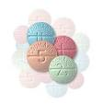
Warfarin Sodium 4
Supplied in different
Strengths
Shapes
Colors
Notes:
Unlike most medications, Warfarin sodium is supplied as a color coded pill based upon the strength of the tablet; each Warfarin sodium tablet color represents a specific strength. As with any medication, staff are never allowed to split tablets to get the correct dose, this must be done by a pharmacist.

Slide 23
Warfarin Sodium 5
Administered at the same time each day helps
To maintain a consistent blood level
With accuracy of PT/INR results
Notes:
Administering Warfarin sodium at the same time each day helps to maintain a consistent blood level and with the accuracy of the PT/INR results.

Slide 24
Two Person Check
The MAP Certified staff assigned to med administration
Prepares the warfarin sodium
Completing 3 cross checks of the 5 rights
Notes:
A two person check is required to ensure the correct dose of warfarin sodium is prepared.

Slide 25
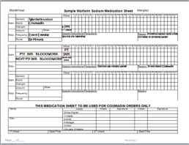
Dose Verification
The second MAP Certified staff
Compares the
To ensure the tablet in the med cup is the dose ordered
Notes:
The second Certified or Licensed staff should compare the Health Care Provider order, to the pharmacy label, to the medication sheet and verify that the correct Warfarin dosage was placed in the medication cup. The second person is verifying that the correct dose was prepared, not watching that medication is being administered.

Slide 26
Warfarin Sodium 6
Med sheets must include
Next PT/INR date
Start/Stop dates
2 person check
Special precautions
Notes:
Warfarin sodium should be transcribed onto dedicated Warfarin Sodium med sheets.

Slide 27
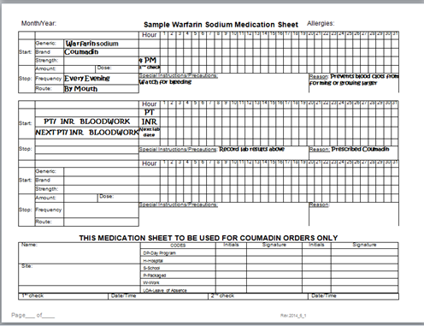
Sample Med Sheet
Notes:
Notice the spaces for Start/Stop dates, second staff check, next PT/INR date, and special Precautions. At this time, review samples of the Warfarin sodium med sheets your agency will be using.

Slide 28
No Second Staff Available
Notes:
If only one Certified/licensed staff is available the dose may still be administered. To document this, the first staff enters a circled ‘X’ in the second check medication box. The circled ‘X’ indicates a second Certified staff was not available to verify the dose. A circled X may be utilized and added to the acceptable code list on Warfarin sodium medication sheets only, an additional progress note would not be required.

Slide 29
HCP Orders
If received from an Anticoagulation Management Service (Coumadin Clinic)
Must be signed by a HCP
Telephone orders must be signed by the HCP within 72 hrs.
Notes:
As with all HCP orders, any orders received from a Anticoagulant Management Service (or Coumadin Clinic) must be signed by the HCP to be valid. Whenever there is a change in HCP Warfarin sodium orders, the change must be communicated to all staff (verbally or in writing), a narrative note written, a ‘directions change’ sticker or brightly colored sticker applied to the medication container to indicate there is a new HCP order that must be checked, the old order dc’d on the med sheet and the new order transcribed. The pharmacy must be contacted anytime there is a change in HCP orders.

Slide 30
Prescription
If the dosage is not stabilized (frequent dose changes)
HCP may provide pharmacy with prescription which does not include a dosage, but will only include tablet strength
‘as directed by current HCP’
Notes:
When the dosage of Warfarin sodium is not stabilized and there will be frequent dosage changes, it is acceptable for the Health Care Provider to provide the pharmacy with a prescription that does not include a specific dosage amount.
The label instructions would read, “as directed by HCP order”; staff must look at the HCP order to determine the number of tablets to give to equal the dose.

Slide 31
Pharmacy Label
Individual’s name
Medication name (Warfarin sodium)
Strength (e.g. ,2mg)
Route (by mouth)
Notes:
For example, the prescription for the pharmacy label would include: The individual’s name, the medication name, the strength; 4. the route; 5. the frequency and 6. No specific dosage directions. It would be ‘as directed by current Health Care Provider order’.

Slide 32
Tracking
Follow agency policy
Blister pack monitoring
Add to count
Flow Record or Event Sheet
Notes:
Each agency must have a tracking method in place for Warfarin sodium. Some examples of tracking are listed above. If blister pack monitoring is done, be sure to include the date, time and initials of the staff administering the medication on the back of the blister pack for each dose administered. If added to the count, each strength of Warfarin sodium must be entered on a separate line on the index and have a corresponding count page. Flow Records or Event Sheets can be used to record HCP orders and lab dates as they continue to change. At this point in your training, pass out any copies of any tracking forms your agency will be using for staff to review.

Slide 33
Policy
Warfarin sodium agency policy to include
Training of MAP Certified staff
Emergency procedures
Notes:
The agency policy must include administrative procedures to be followed when there is a medical emergency related to the administration of Warfarin sodium. Again, at this point in your training, pass out copies of your agency Warfarin Sodium Policy for staff to review.

Slide 34
Protocol
Individualized Warfarin sodium protocol to include
Details of how HCP orders are obtained
Process for obtaining
PT/INR lab draw
PT/INR lab results
Target INR Range
Notes:
Each individual who has Warfarin sodium ordered must have an individualized Warfarin sodium protocol. The protocol would be signed by the HCP and kept in the medication book with the HCP orders. Pass out and review any individual specific protocols at this time for staff to review.

Slide 35
Adverse Effects
Increased risk for bleeding
Report to the HCP
Unusual easy bruising
Prolonged bleeding from
cuts
gums
Frequent nosebleeds
Notes:
On the screen are a few of the signs and symptoms a person may experience from too much Warfarin sodium. Changes observed should be reported to the HCP as soon as they are noticed. They could be life-threatening.

Slide 36
Adverse Effects 2
Increased risk for bleeding
Report to the HCP
Black tarry stools
Persistent weakness/tiredness
Nausea/vomiting, stomach pain
Notes:
On the screen are more signs and symptoms of bleeding. A high INR can be treated by administering Vitamin K. This would require an HCP order. Remember, Vitamin K plays a major role in blood clotting and when prescribed will help lower the…excuse me. When prescribed, will help INR thereby decreasing the risk for bleeding. Know and follow your agency policy for medical emergencies by calling 911 if needed.

Slide 37
Safety
Decrease risk of bleeding by
Using
an electric razor for shaving
a soft-bristle toothbrush
waxed dental floss
Being cautious with knives or scissors
Preventing falls
Not missing lab appointments
Notes:
Prevention is key to Safety! Do not miss lab appointments! This is the only way to know if the PT/INR is in the Target INR Range!

Slide 38
Training
Must be Certified and/or Licensed to administer Warfarin sodium
Certified staff must receive Warfarin sodium Therapy training
Notes:
Certified staff who have not administered Warfarin sodium within a 12 month timeframe must attend a Warfarin sodium retraining.

Slide 39
Remember
Safety and Prevention
Keep all HCP and lab appointments
Give Warfarin sodium at same time each day
Report changes when observed
Monitor diet
Notes:
Remember, safety and Some key points to remember about safety and prevention.

Slide 40
Remember 2
You are key to safe anticoagulation therapy !
Notes:
You are key to safe anticoagulation therapy!

Slide 41
Questions
Notes:
If you have questions on information presented, please contact your MAP Coordinator.
Thank you.

